Slide 1
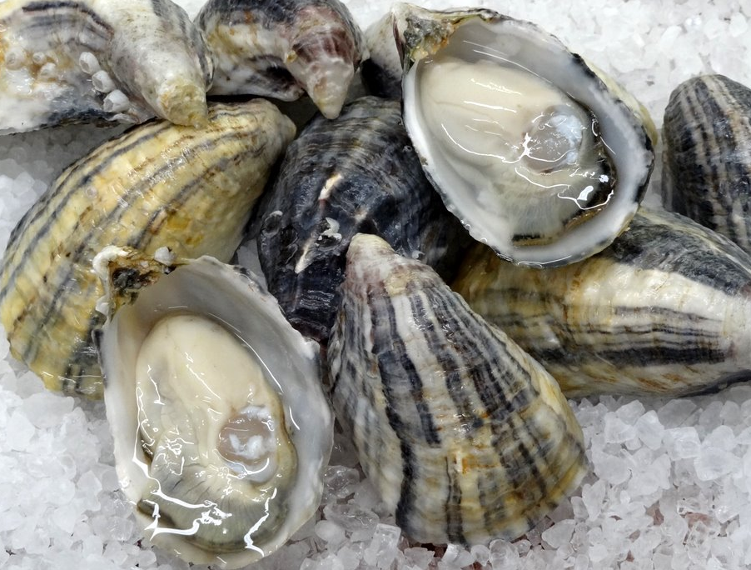
Characterizing Physiological Effects of Multiple Stressors on Crassostrea Gigas in a Wild Setting
Yaamini Venkataraman
Roberts Lab
November 17, 2016
Notes:
Oysters are important species in the Puget Sound region, as they provide crucial ecosystem services and are the basis for several aquaculture operations. Like many other marine calcifiers, oysters are potentially endangered by climate change. Increasingly acidified waters pose a threat to larval development and degrade adult shells. Wild oysters also face a second threat: ocean warming. However, there is a limited set of experiments studying oysters’ response to multiple stressors that mimic the suite of conditions experienced in the wild. We propose a study to examine the physiological effects of multiple stressors — acidification and warming — in both wild and controlled lab settings. Collaborating with the Department of Natural Resources, we will first assess differences in protein expression in the Pacific Oyster, Crassostrea gigas, in different study sites in and around the Puget Sound. We will then use these results to inform a controlled lab experiment that examines the underlying epigenetic processes influencing protein expression under varying conditions.
• Introduction to oysters in PNW
◦ list problems facing oysters
◦ we're focusing on OA and warming
• OA and warming occur together, but we haven't seen many experiments detailing effects of both on oysters
• we want to understand how combined stressors affect epigenetic and proteomic responses of C. gigas in wild and lab settings
◦ mimic suite of future conditions
◦ are epigenetic and proteomic responses stress specific?
▪ we think yes
◦ try and have lab settings reflect wild conditions as much as possible
• Experimental plan
• -DNR collaboration: wild setting, exploratory study
• - 2 rounds, 5 different sites (show map), eelgrass vs. bare
• - epigenetic and proteomic analysis
◦ use DNR results to inform lab experiment, mechanistic study
▪ controlled temp/pH based on environmental data, predictions of future conditions
▪ epigenetic and proteomic analysis
• example of how epigenetic/proteomic analysis works (possibly using my class project?)

Slide 2

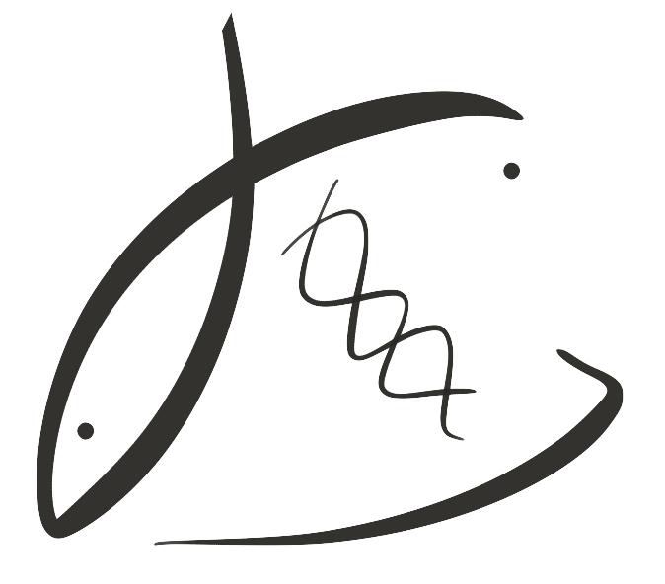

Outline
Introduction to oysters
Environmental threats
Ocean Acidification
Ocean Warming
Experiment Proposal
Department of Natural Resources
Example Analysis
Title Photo from Willapa Oysters

Slide 3
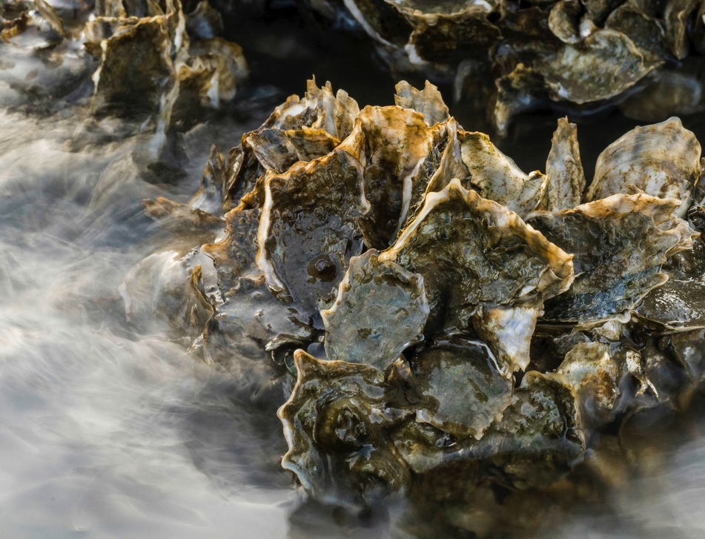
Oysters and the Ecosystem
fish habitat
shoreline stabilization
water filtration
Photo from The Nature Conservancy
Notes:
Aside from being important in aquaculture (cite some really cool statistics), oysters have a crucial role in the ecosystem

Slide 4
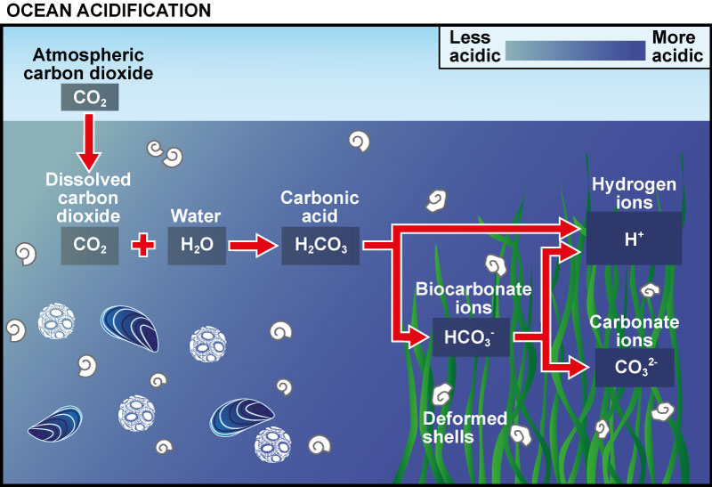
Climate Threats
water filtration
fish habitat
shoreline stabilization
Graphic adapted from the University of Maryland
Notes:
While several studies have shown the deleterious effects of climate change and oa on oyster larvae/marine calcifiers, adults are also affected
Remake diagram
Give examples of studies

Slide 5
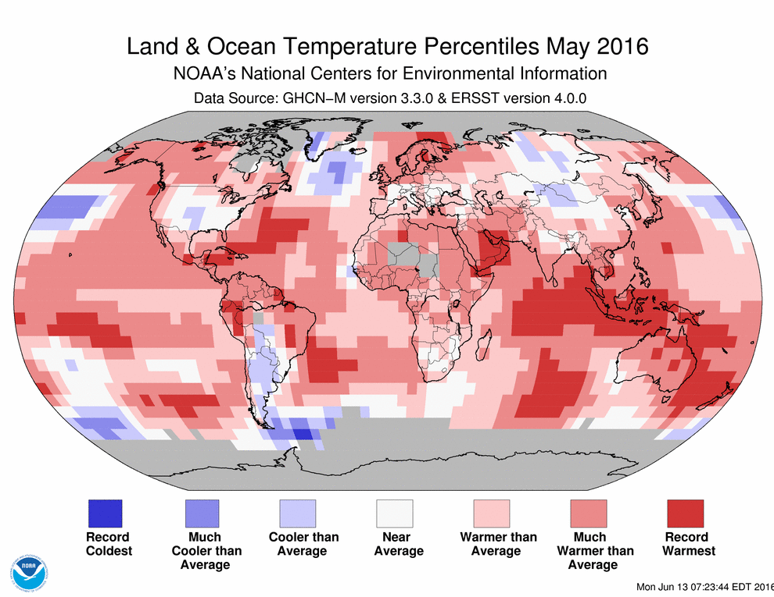
Climate Threats
water filtration
fish habitat
shoreline stabilization
Notes:
Data about phenomenon
Studies with temperature on oysters

Slide 6
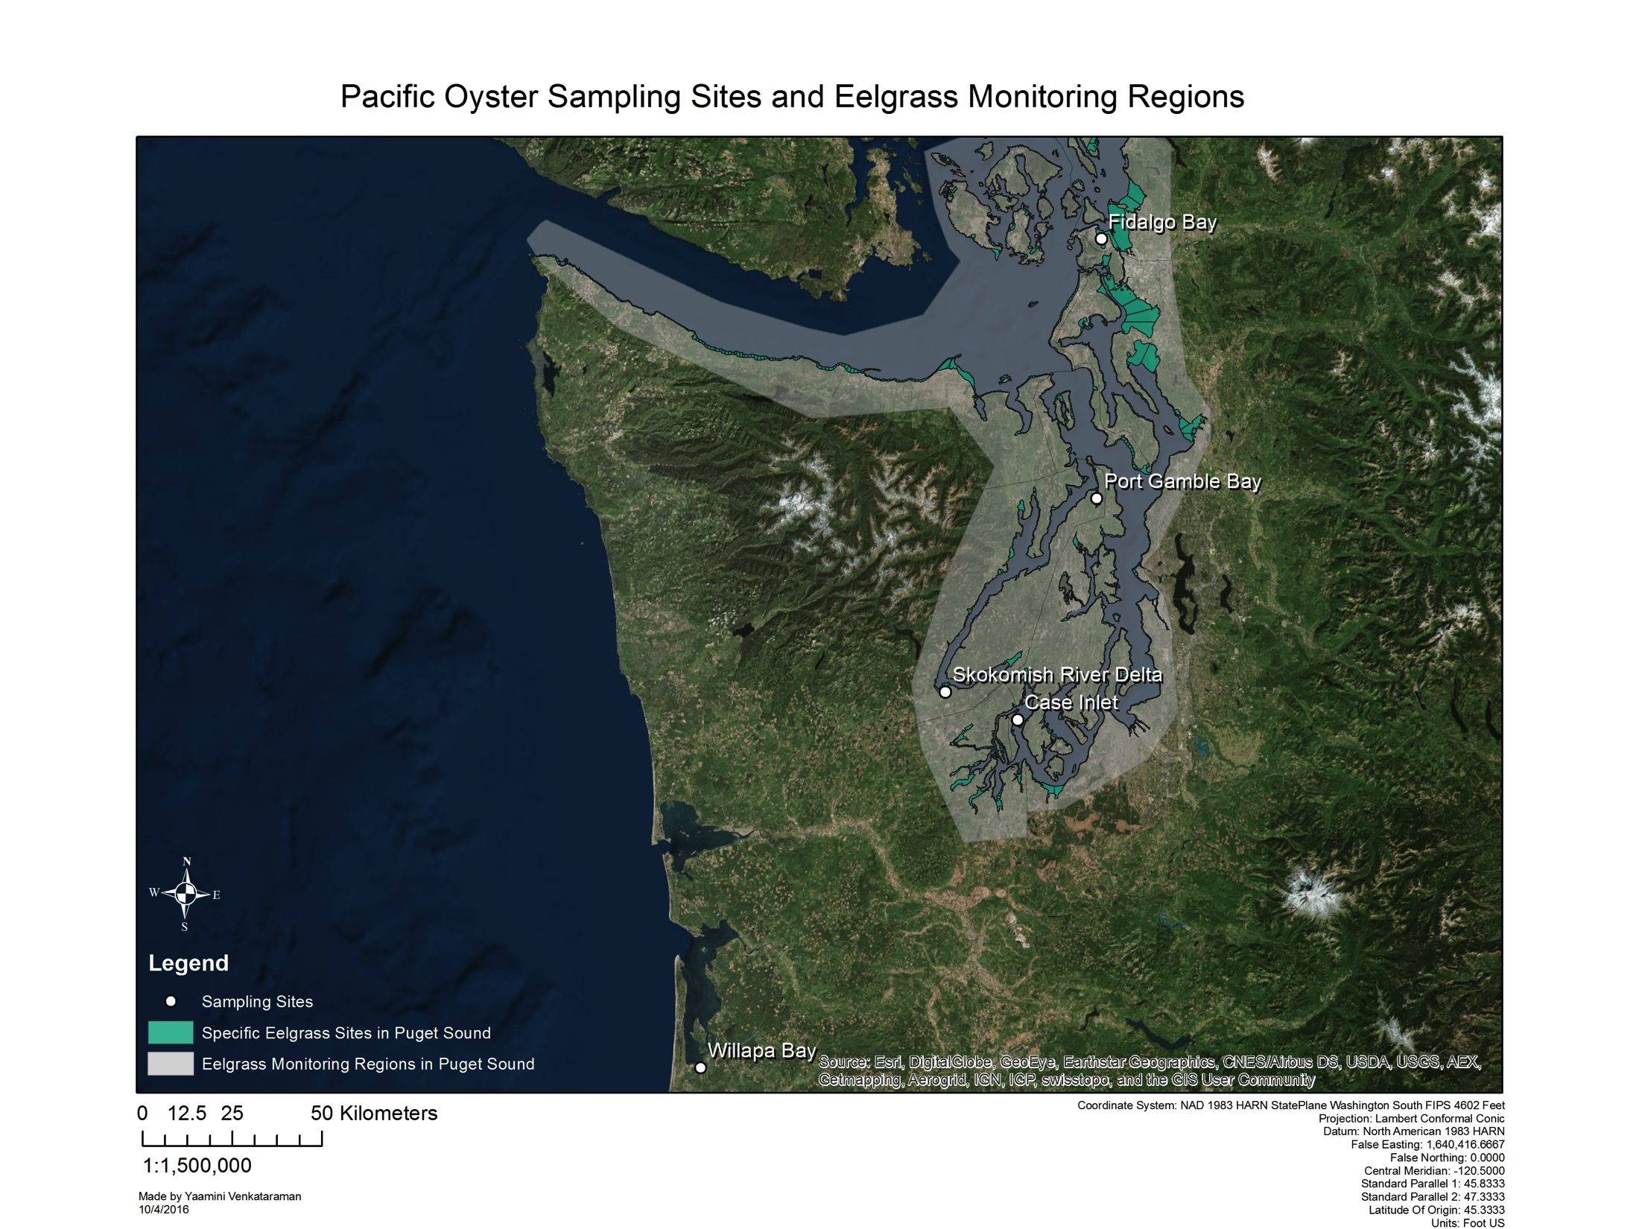
Collaboration with DNR
300 sibling C. gigas specimens
5 sample sites
June-July 2016 vs. July-August 2016
Eelgrass presence vs. absence
Notes:
Introduce DNR sample sites and basic experimental overview
DNR has been studying eelgrass since [insert time here]

Slide 7
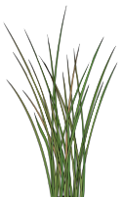
Experimental Overview
150 total oysters
2 Rounds: June
and July
outplant to 5 sites
3 replicates
eelgrass vs. no eelgrass
Water chemistry data (temperature, dissolved oxygen)
DNA extraction
Protein extraction
Notes:
Diagram explaining experimental methods

Slide 8
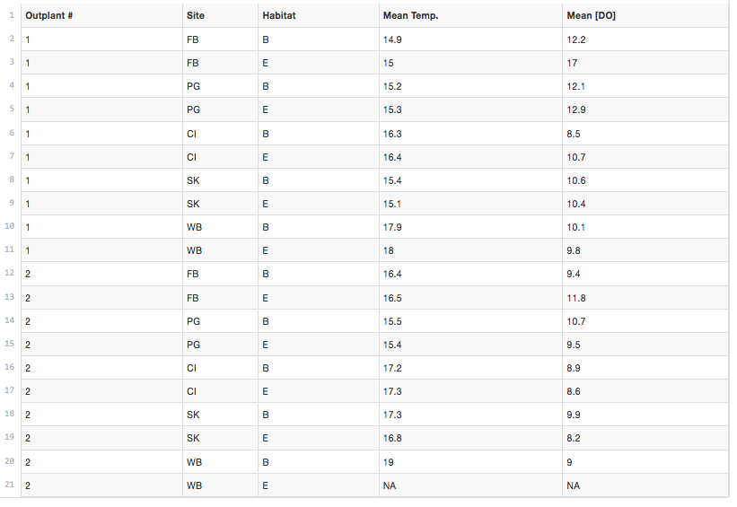
Preliminary Data
Plan: graphs comparing mean temp and DO for different sites
Notes:
Preliminary graphs/photos of water chemistry analysis

Slide 9
Hypotheses
Differences in gene expression, epigenetic and proteomic responses between the following:
Experimental rounds (temperature)
Eelgrass presence
Water chemistry (pH)
Notes:
Hypothesis about the following relationships based on water chemistry, temperature differentials, pH differentials, etc.
Make more specific with different protein names

Slide 10
Proposed Analyses
DNA extraction
Protein extraction
Sequence DNA
Shotgun proteomics
Differential expression
Epigenetic variation
Targeted proteomics
Notes:
To test these hypotheses, we’ll use these analytical methods
Diagram of workflow → what analytical outputs are inputs for other programs?

Slide 11
Analysis Example
SCREENSHOT OF DNA METHYLATION/SOME OTHER REALLY COOL VISUALLY APEALING ANALYSIS GOES HERE!!!!!!!!!!!!!!!
Notes:
Diagram explaining experimental methods

Slide 12
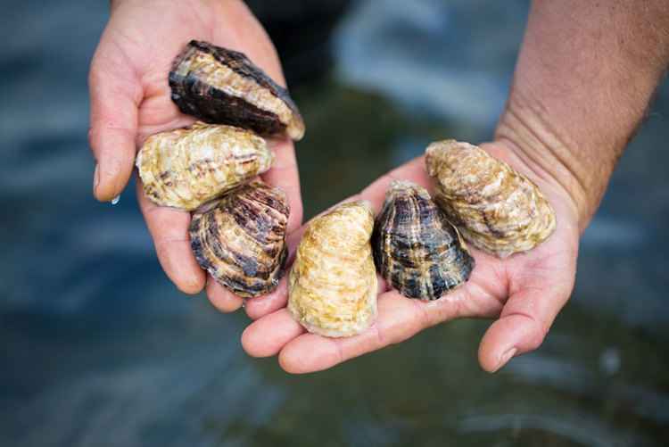
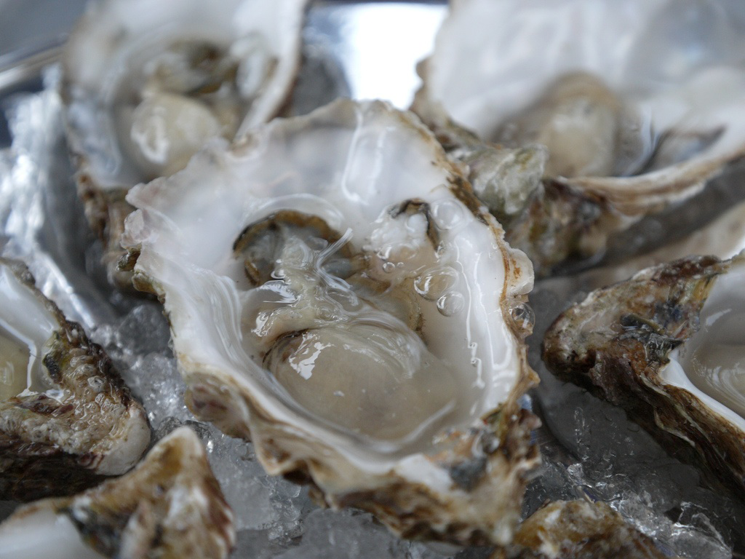
Looking Forward
Study effects of several environmental conditions in one experiment
Hypotheses
Eelgrass
Temperature
pH
Apply findings to mechanistic lab study
Notes:
Hypotheses
Potential timeline
Talk about how it can be used to inform this really cool lab study

Slide 13
Thank You!
Yaamini Venkataraman
yaaminiv@uw.edu
https://github.com/RobertsLab/project-oyster-oa
Notes:
Oysters are important species in the Puget Sound region, as they provide crucial ecosystem services and are the basis for several aquaculture operations. Like many other marine calcifiers, oysters are potentially endangered by climate change. Increasingly acidified waters pose a threat to larval development and degrade adult shells. Wild oysters also face a second threat: ocean warming. However, there is a limited set of experiments studying oysters’ response to multiple stressors that mimic the suite of conditions experienced in the wild. We propose a study to examine the physiological effects of multiple stressors — acidification and warming — in both wild and controlled lab settings. Collaborating with the Department of Natural Resources, we will first assess differences in protein expression in the Pacific Oyster, Crassostrea gigas, in different study sites in and around the Puget Sound. We will then use these results to inform a controlled lab experiment that examines the underlying epigenetic processes influencing protein expression under varying conditions.
• Introduction to oysters in PNW
◦ list problems facing oysters
◦ we're focusing on OA and warming
• OA and warming occur together, but we haven't seen many experiments detailing effects of both on oysters
• we want to understand how combined stressors affect epigenetic and proteomic responses of C. gigas in wild and lab settings
◦ mimic suite of future conditions
◦ are epigenetic and proteomic responses stress specific?
▪ we think yes
◦ try and have lab settings reflect wild conditions as much as possible
• Experimental plan
• -DNR collaboration: wild setting, exploratory study
• - 2 rounds, 5 different sites (show map), eelgrass vs. bare
• - epigenetic and proteomic analysis
◦ use DNR results to inform lab experiment, mechanistic study
▪ controlled temp/pH based on environmental data, predictions of future conditions
▪ epigenetic and proteomic analysis
• example of how epigenetic/proteomic analysis works (possibly using my class project?)

